Slide 1
PIZZA SALES ANALYSIS The project analyzes pizza sales data using sql to uncover trends and provide actionable insights for optimizing business performance. it involves querying and analyzing data to evaluate sales, customer behavior, and revenue patterns.

Slide 2
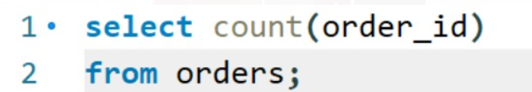
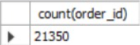
Queries:
Retrieve the total number of orders placed:

Slide 3
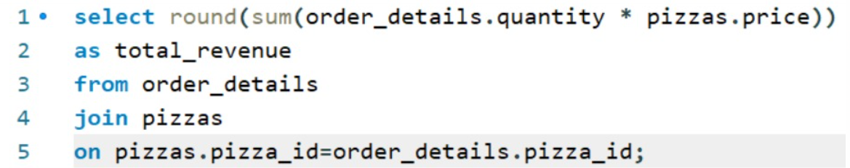
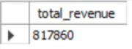
Calculate the total revenue generated from pizza sales:

Slide 4
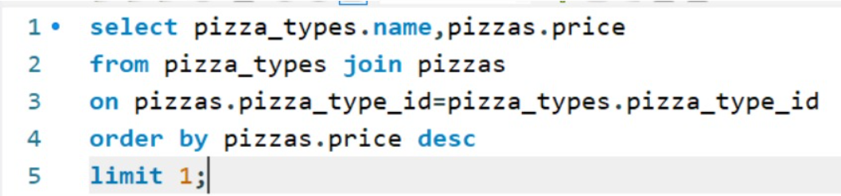
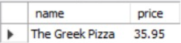
Identify the highest-priced pizza.

Slide 5
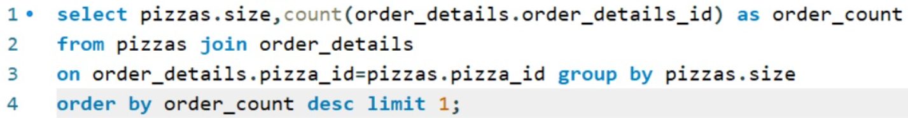
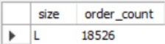
Identify the most common pizza size ordered.

Slide 6
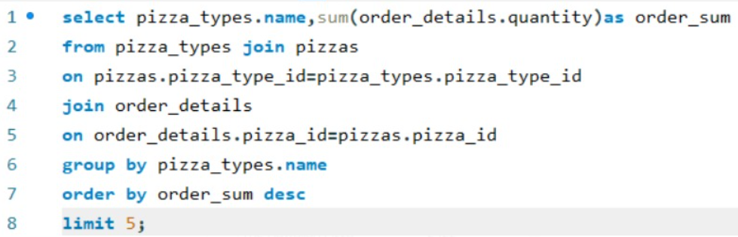
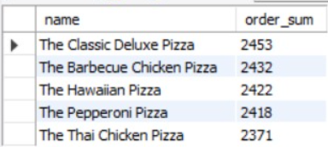
List the top 5 most ordered pizza types along with their quantities.

Slide 7
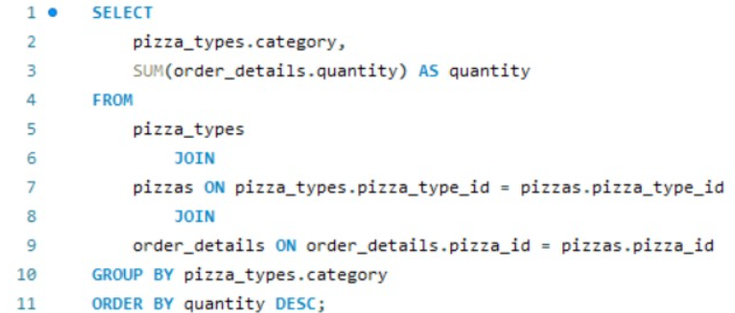
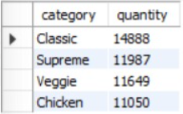
Join the necessary tables to find the total quantity of each pizza category ordered.

Slide 8
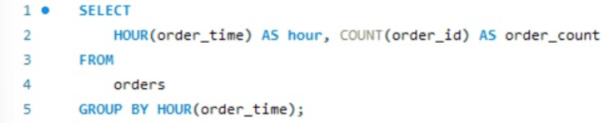
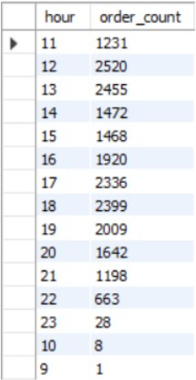
Determine the distribution of orders by hour of the day.

Slide 9
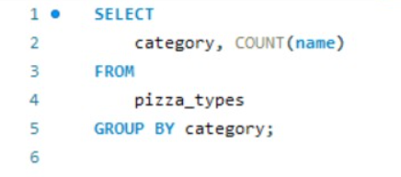
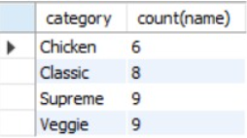
Join relevant tables to find the category-wise distribution of pizzas.

Slide 10
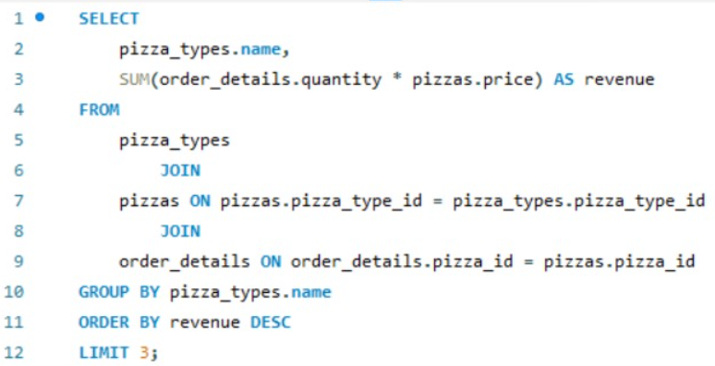
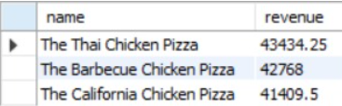
Determine the top 3 most ordered pizza types based on revenue.

Slide 11
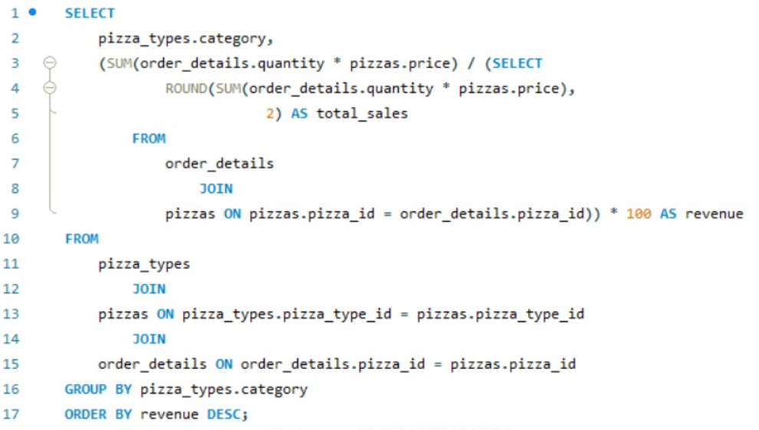
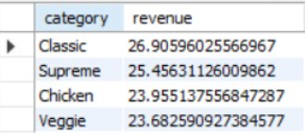
Calculate the percentage contribution of each pizza type to total revenue.

Slide 12
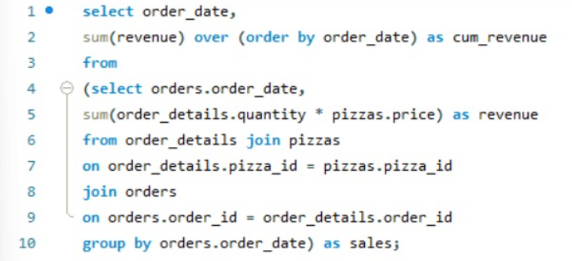
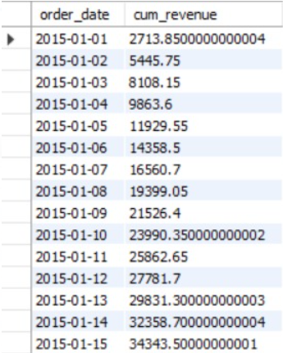
Analyze the cumulative revenue generated over time.

Slide 13
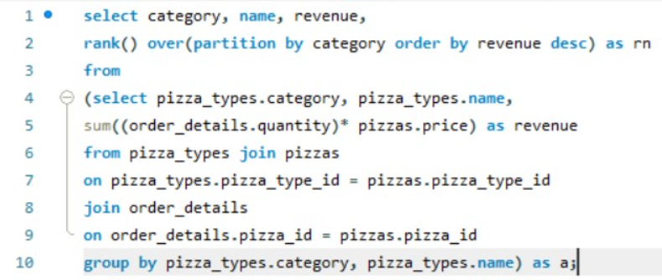
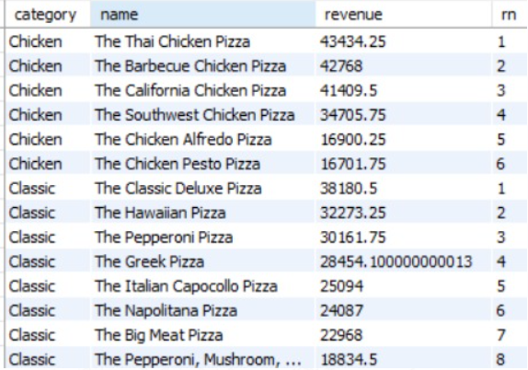
Determine the top 3 most ordered pizza types based on revenue for each pizza category.

Slide 14
Thank you

